Slide 1
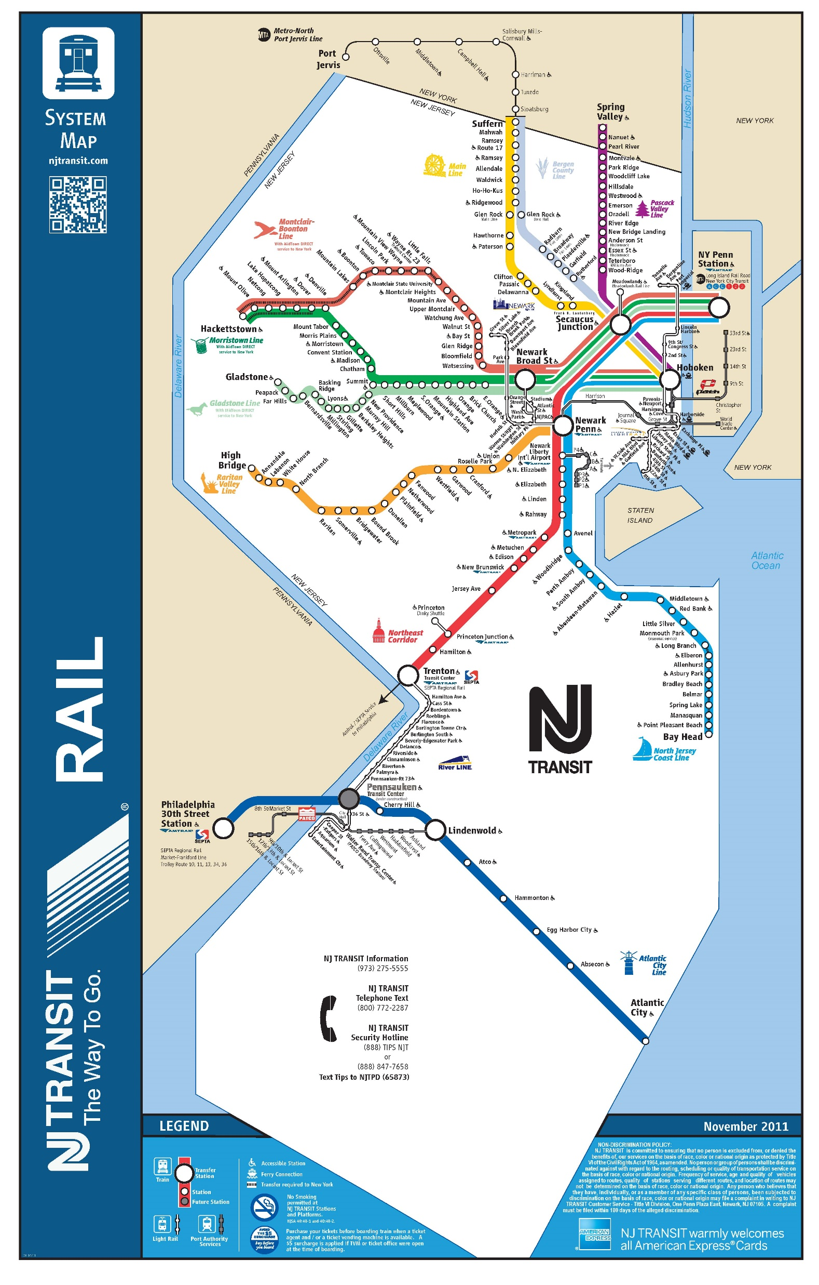

Delay Estimator
A Forecasting Tool for New Jersey Train Delay
MUSA 508 Fall 2021
Final: Project 4
Jasmine Siyu Wu and Zoe Yoo
Notes:
For our final project, the app that Jasmine and I chose to develop is a Delay Estimator, or a delay prediction model that forecasts rail delay on the New Jersey transit system. With both heavy rail and light rail in the system, New Jersey transit serves as commuter rail between Philadelphia, New Jersey, and New York City.

Slide 2
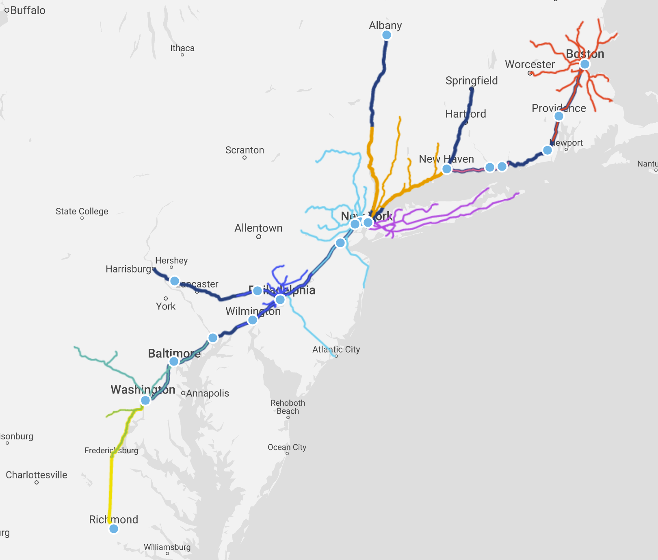
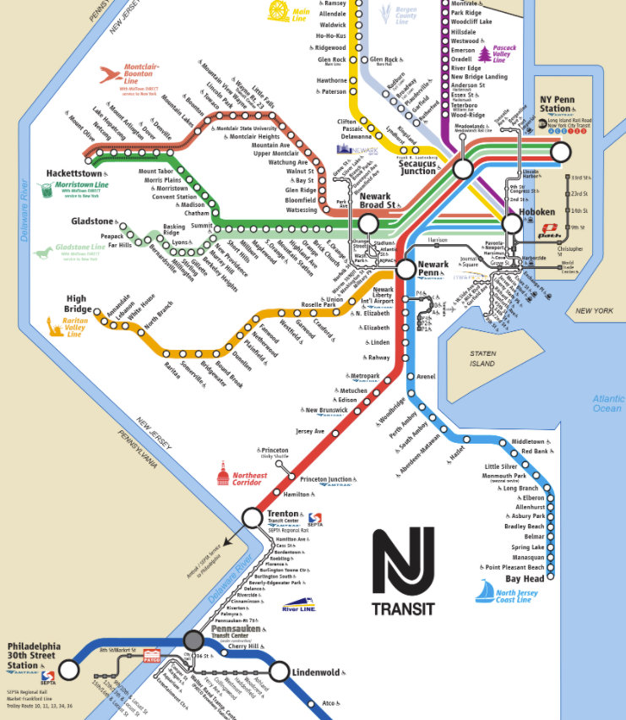

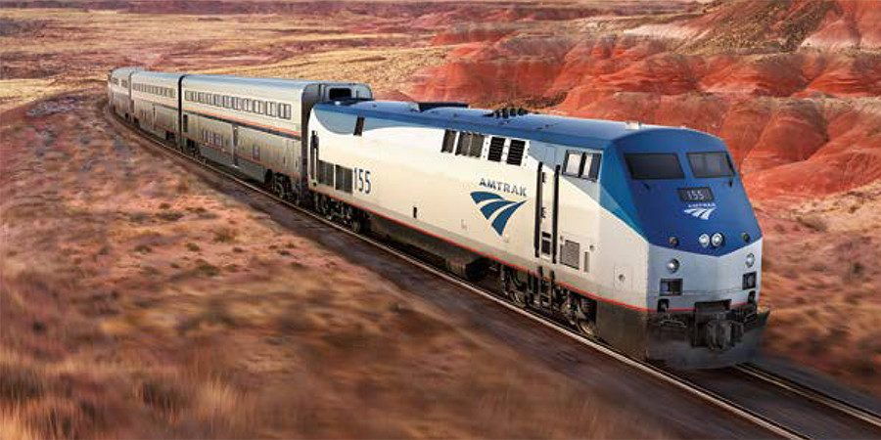
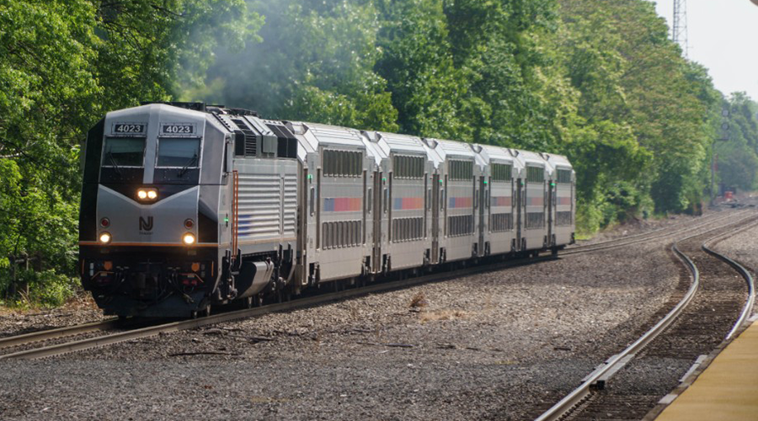
Scope
Initial idea to develop delay estimates for Amtrak and NJ online ticketing
Similar geographies, but data constraints
No scheduling times in Amtrak data
Photo sources: Amtrak, NJ Transit
Notes:
Amtrak is also commuter rail for the Northeast, so we originally planned to develop a website add-on for people buying their train tickets in advance. However, the Amtrak data does not include schedule times, which left us only with NJ Transit data. New Jersey Transit also has a different system than Amtrak: it only sells tickets on its mobile app, or in person.

Slide 3
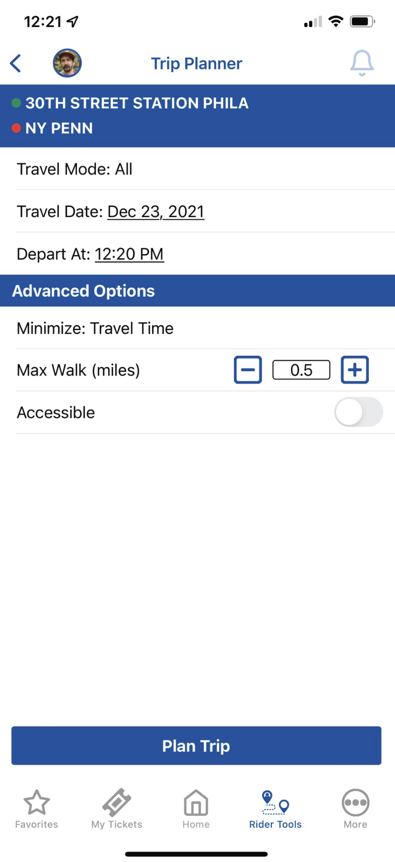

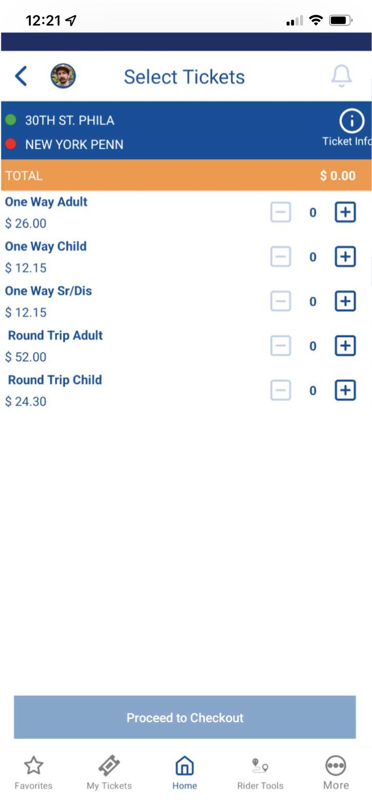
NJ Transit
New Jersey system differs from Amtrak
One-way tickets or passes, with no expiration date
Ticket prices vary based on distance but not time of reservation
Tickets can only be bought on the NJ Transit Mobile App or in-person
Trip Planner gives users scheduled trains based on date and time
Notes:
Additionally, its ticket prices do not fluctuate like Amtrak tickets, which vary based on date of reservation. Because of this, predicting delay far in advance is not as important for our project. So, we decided to conceptualize a tool for the New Jersey Transit App, and in particular, its Trip Planner feature. This feature allows riders to look at future trips for a specific date and time.

Slide 4
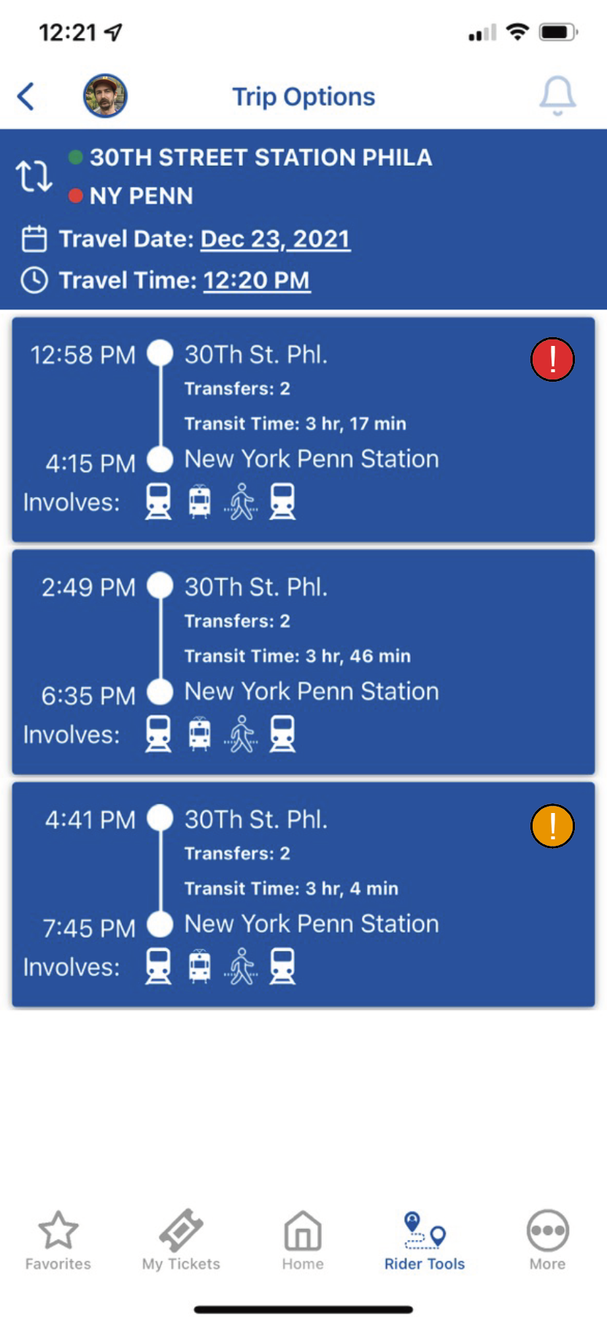



Trip Option Delay
Each time option shows the total predicted delay for that trip
Red = >30 minutes combined predicted delay
Orange = 20-30 minutes combined predicted delay
Yellow = 10-20 minutes combined predicted delay
Notes:
In the resulting "Trip Options" screen, we aim to add an indicator for possible delay for each schedule option available, that refers to the total predicted time delay for each trip. Yellow indicates 10-19 minutes combined predicted delay, orange for 20-29 minutes, and red for over 30 minutes. There is no indicator for under 10 minutes, as we consider that "acceptable."

Slide 5
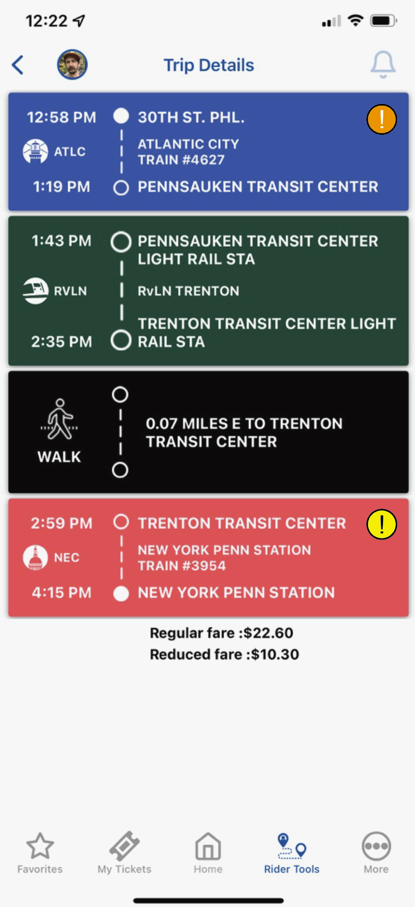
Detailed Trip View
Each leg of trip shows predicted possible delay
Categorized below and summed for the overall trip
Note: current data is only commuter rail, not light rail
Red = >30 minutes combined predicted delay
Orange = 20-30 minutes combined predicted delay
Yellow = 10-20 minutes combined predicted delay
Notes:
In the Detailed Trip View, we would also add the same icons and categorization color scheme for each leg of a trip. For an entire trip, these would all be summed up and displayed accordingly.

Slide 6
Data Structure
NJ Transit DepartureVision Real Time Train Status Service
Aggregated on Kaggle by Pranav Badami
Sample months: January and February 2021
Basic Data
Train ID
Type (Amtrak or NJT)
Spatial Data
Start Station Name and ID
End Station Name and ID
Stop Sequence Number
Line Name
Temporal Data
Scheduled Time of Departure
Actual Time of Departure
Calculated Delay (minutes)
Date
Notes:
We are mainly using a dataset from Kaggle, which scrapes its data from the NJ Transit DepartureVision Real Time Train Status service. Our sample months are January and Feburary 2021. The dataset is made up of basic identification, spatial, and temporal data. We have also added weather data through the RIEM R package.

Slide 7
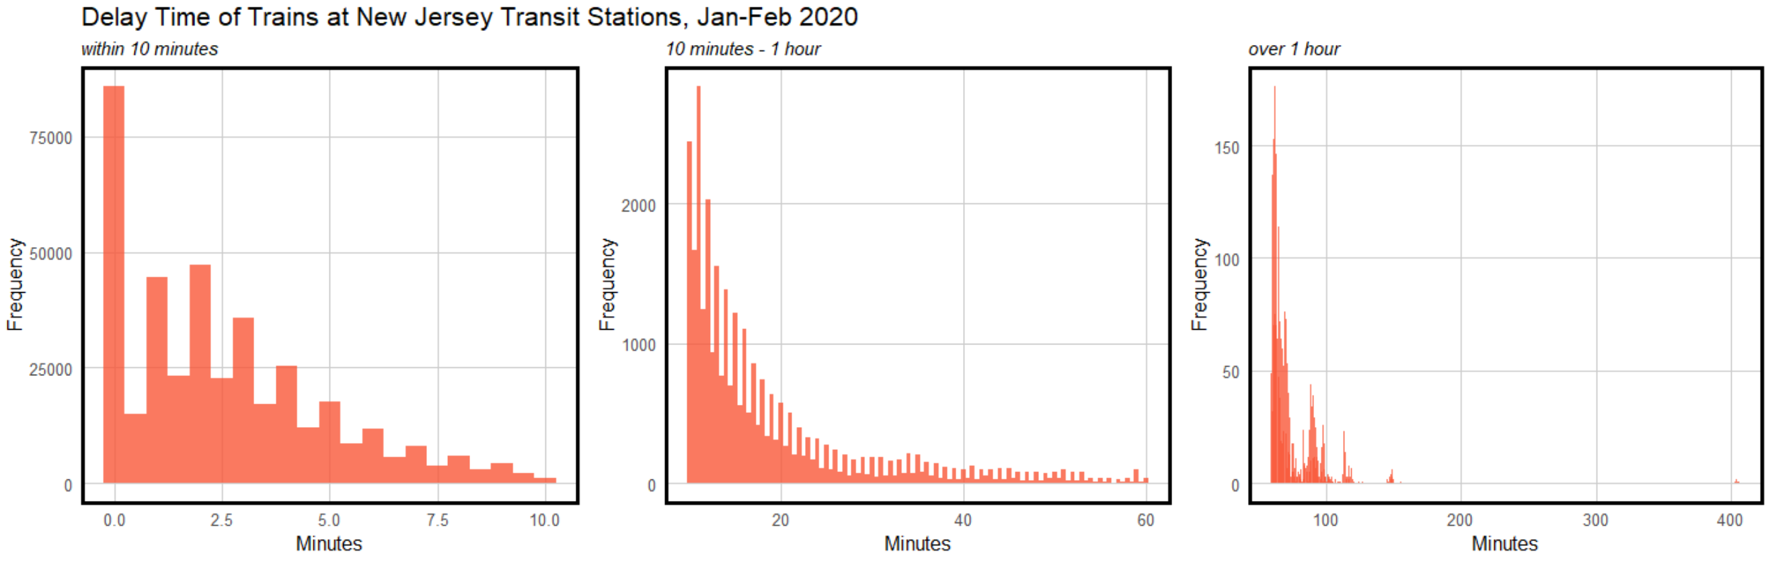
Reviewing the Data
Is delay often / severe enough to warrant a tool for it?
Notes:
We first needed to actually determine if delay is severe enough often enough to warrant developing a model. As you can see, most trains in our sample set are delayed under ten minutes, with frequency reaching very low levels for delay over 40 minutes, and even less for over an hour.

Slide 8
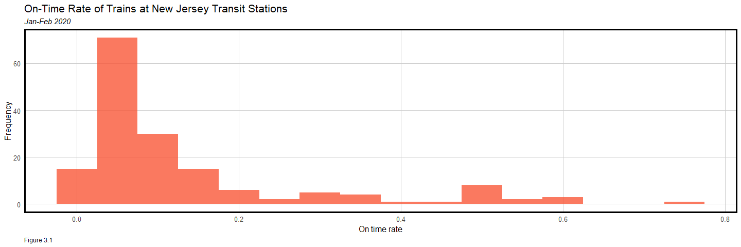
On Time
On time: % of trains arriving at the scheduled time at each station stop on a journey
Definition source: Southern Railway, “Train service punctuality and reliability”
Notes:
. To further examine delay, we used two metrics from the UK Southern Railroad; the first, "on time," considers the percentage of trains that arrive at each stop on schedule. For New Jersey Transit, the on-time rate of trains is usually low, with most trains only reaching each stop at its scheduled time 10-20% of the time.

Slide 9
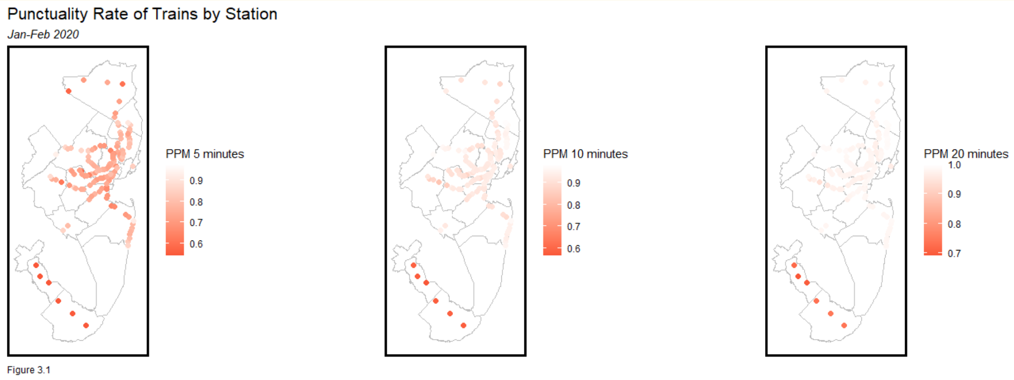
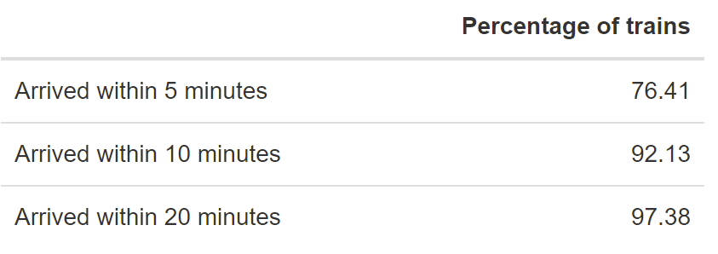
Public Performance Measure (PPM)
Public performance measure (PPM): % of trains arriving at their destination within 5 minutes of schedule
Philadelphia-Atlantic City Line has the lowest PPM
Definition source: Southern Railway, “Train service punctuality and reliability”
Notes:
The second indicator is the "Public Performance Measure," which refers to the percentage of trains that arrive at their stops within 5 minutes. Even using different brackets for PPM, it is clear that PPM varies spatially (and is especially low on the Philly-Atlantic City line). So, we concluded that there are sufficient delays within the system to warrant modeling.

Slide 10
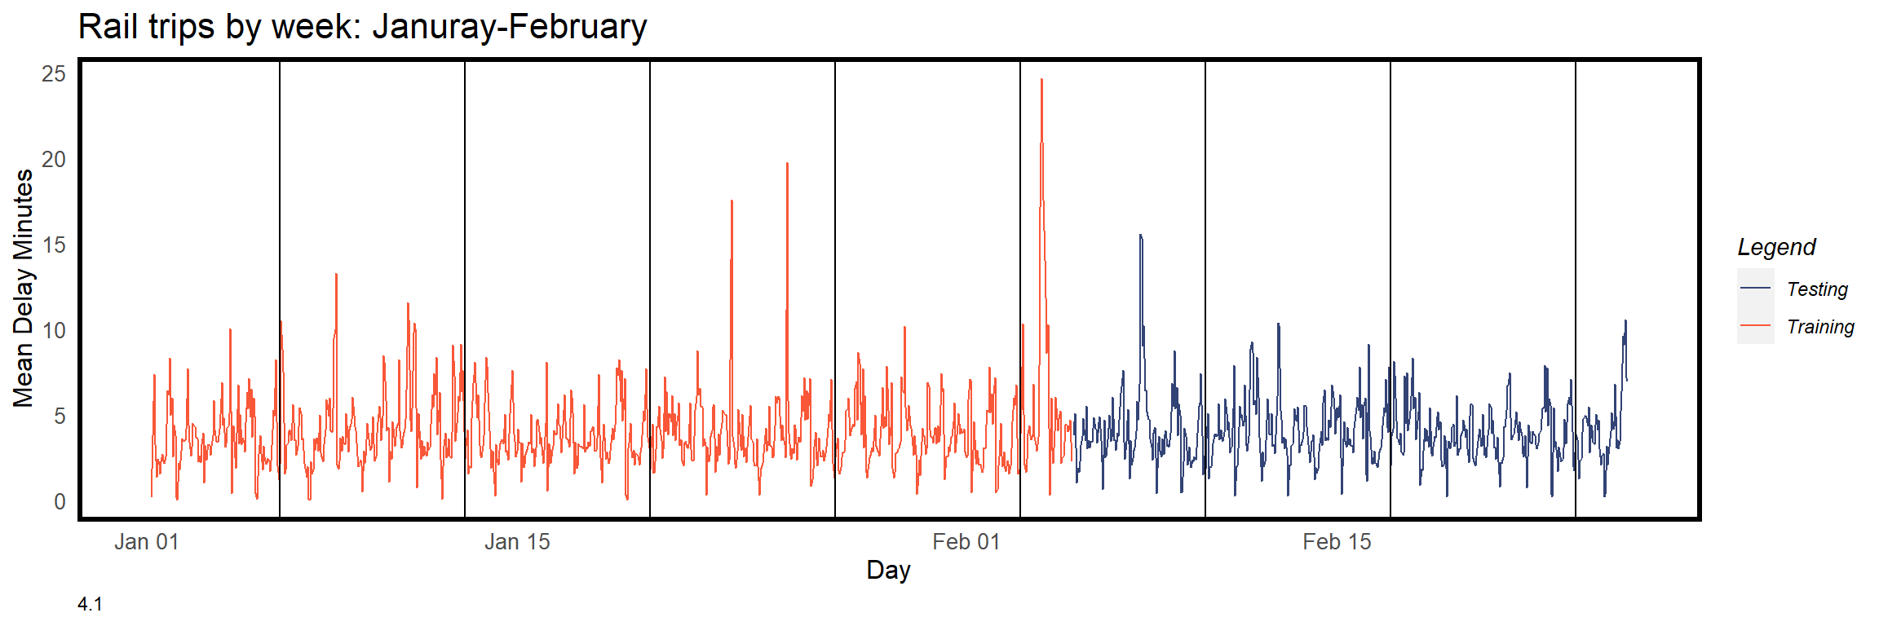
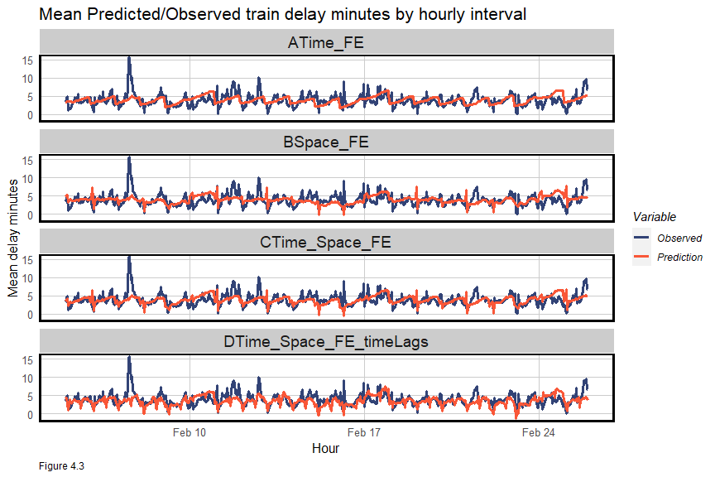
Regression Model
Split: Train on first five weeks, test on last three
Four different models:
A. Time – time of day, day of the week
B. Space – origin and destination stations
C. Time, Space, Weather (temperature/precipitation)
D. Time, Space, Weather, & Time Lag
Notes:
. For our models, we train on the first five weeks and test on the last three. So far, we have developed four different models with increasing levels of detail: time, space, weather, and time lag data. From testing these predictions, we can see that our most detailed model predicts general trends and small delays well, but misses periods of long delay.

Slide 11
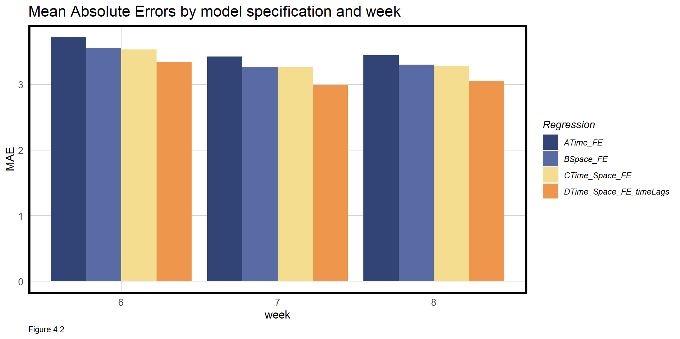
Results
Improving Accuracy
Greater computing power
Use a larger sample size of data to ideally gain more accuracy year-round
Improve on the current model
Add more variables, e.g. Number of previous stops
Add more independent data
Notes:
It is clear that Mean Absolute Error decreases with the models that have additional independent variables. A couple of our ideas on improving accuracy are to expand our sample size to allow us to train on more data, and to improve on the current model by adding more variables or finding other relevant independent data such as weather.

Slide 12
Future Possibilities
Increase scope
Find scheduling data for Amtrak
Expand data scope to SEPTA or NJ light rail, which connect to NJ Rail Transit
Other uses
Use to figure out the possible causes delay, and how to mitigate it, before it has the chance to affect customers
Notes:
Our current idea for the Delay Estimator is fairly simple, but has great potential to be expanded on. With more data, especially data on Amtrak and SEPTA, as they both are used as connectors or replacements for NJ transit, this estimator could be used for the benefit of more customers. With enough planning power, agencies could use this tool to predict and mitigate delays before they happen.

